Slide 1
Coursera Capstone
Opening a new Chinese Restaurant in Washington D.C

Slide 2
Businesses are hard to establish. Most fail within the first 2 years, but what if by using data science you could get a better understanding of the area you were looking to purchase. Who is your competition, and where is the best place to start a new venture?

Slide 3
Foursquare Data
Using Foursquare API data we can run analysis on the current businesses in the Washington DC area

Slide 4
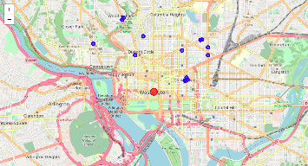
Where is the competition?
First things first, where in DC are the other Chinese restaurants located? Using the explore API and plotting the locations on a map we can see Chinese places are scattered, and have a concentration in Chinatown which makes sense. But there is one area that doesn't seem to have any.. Foggy Bottom.

Slide 5
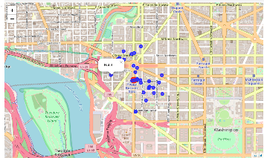
What is in Foggy Bottom?
The next question would be OK if there are not any Chinese restaurants in Foggy Bottom – what is located there? In fact there was a lot around that area..
Hotels
Coffee Shops
American Restaurants
Greek Restaurants
Bakeries
Gyms
Delis and more

Slide 6
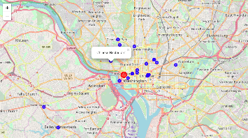
Anything Chinese related?
It would appear Foggy Bottom has a bunch of businesses outside of Chines Restaurants but what about anything related to Chinese? When querying the API for things regarding Chinese within 500 meters of Foggy Bottom it found offices, acupuncturists, churches and the closest Chinese restaurant it found was up near Lees Hill – 63 meters away.

Slide 7
Conclusion
Based on the analysis done using Foursquare Data – It was seen that Foggy Bottom could be a good place to invest given the low competition of other Chinese restaurants and high margins of traffic. Foggy Bottom has various other establishments and this could be the best way of building a successful Chinese restaurant in the D.C area.

